Slide 1


Bartering Books
Prepared By: Guided By:
Karan Bhatt(201803100810008) Mr. Jenish Lavji
Kevin Mehta (201803100810074) Assisitant Professor, DIT
B.Tech. IT (7th Semester) CGPIT.
CGPIT.

Slide 2
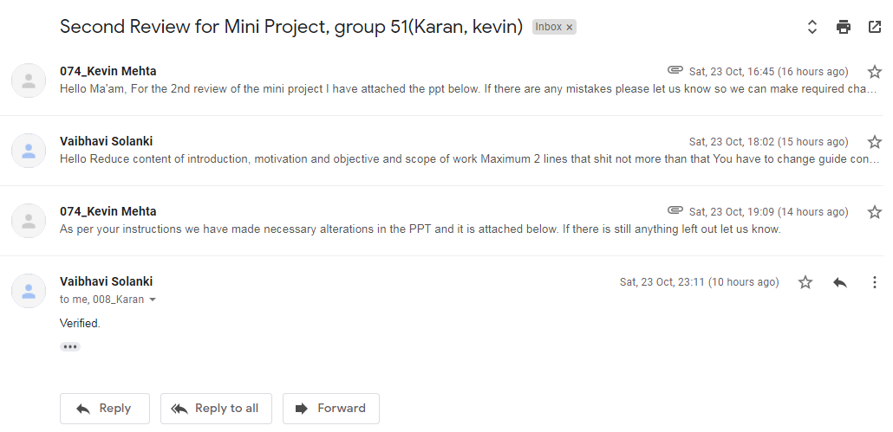
Consent from guide for this presentation

Slide 3
Outline
Introduction
Motivation
Objective
Scope
Analysis for development
Modules
Diagrams
Technologies and Platform used for development
Implementation
Future work
Conclusion
References

Slide 4
Introduction
This platform will allow the users to share books they no longer need and can exchange books by contacting that person.
This platform resolves the time consuming activities like finding a person who wants to exchange books via different contacts or finding means of donating books.

Slide 5
Motivation
Reason for selecting this topic is to lend a helping hand to people having a low capital expenditure and have real needs.
To promote free literacy and education.

Slide 6
Objective
Here, purpose is to provide a platform that provides an inexpensive way for people to exchange books.

Slide 7
Scope
Intended audience is not limited to specific age group.
Anyone can access the platform who wants to exchange books or are in search of different kinds of books.

Slide 8

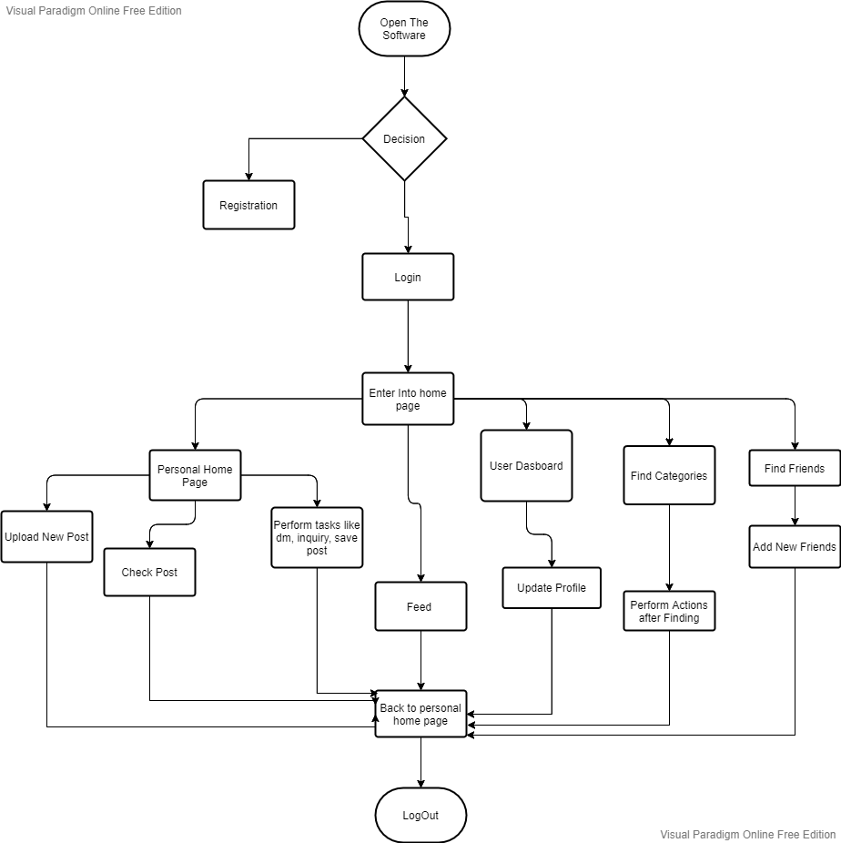
Analysis for development

Slide 9
Modules
Authentication Module:- Registration, Login, Logout.
Inbox:- Send Message , receive Message
Home page:- posts, search, direct message, navigation
Friends:- Add Friend, Send Friend Request, Receive Friend Request.
Feed:- Different posts from different users can be visible.

Slide 10
User Dashboard:- Profile, followers, posts, Friend Requests
Admin Panel:-Where admin can manage different feed and user related details.

Slide 11
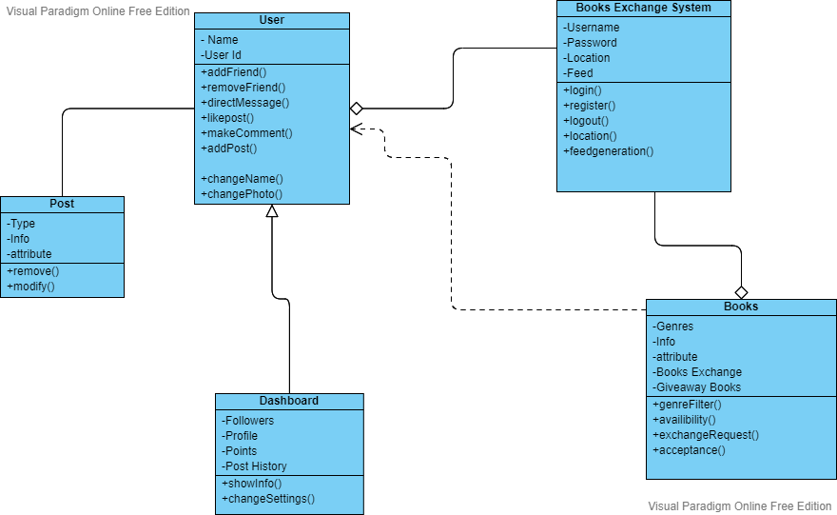
Class Diagram

Slide 12
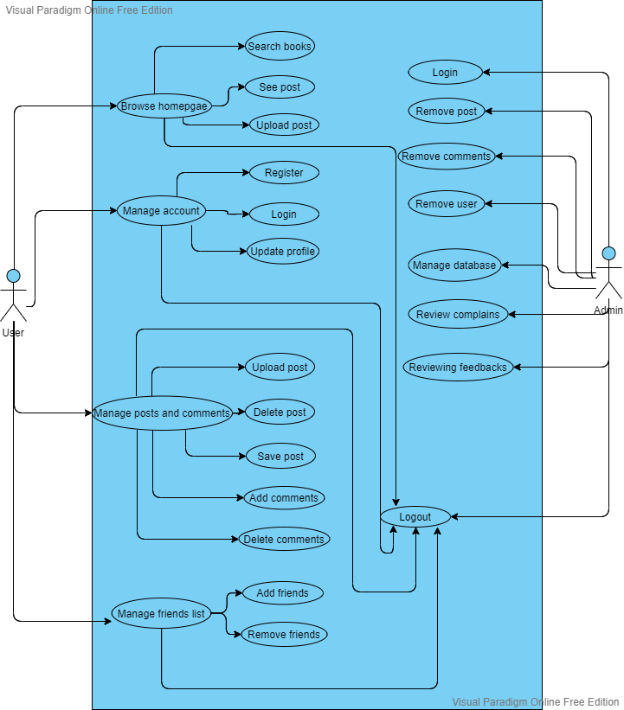
Use Case Diagram

Slide 13
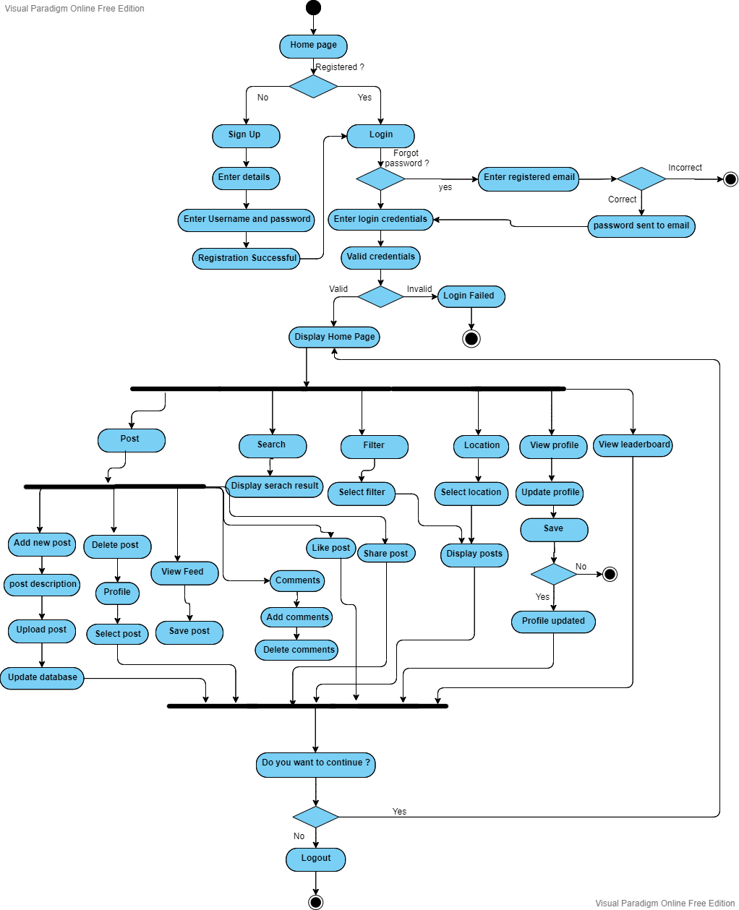
Activity Diagram

Slide 14
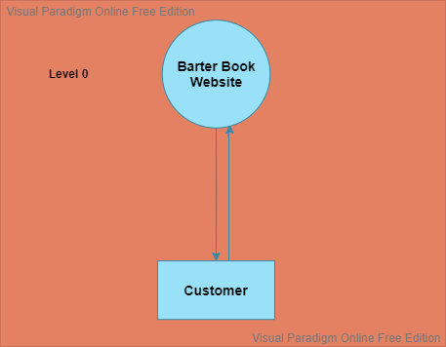
Data Flow Diagram(DFD)

Slide 15
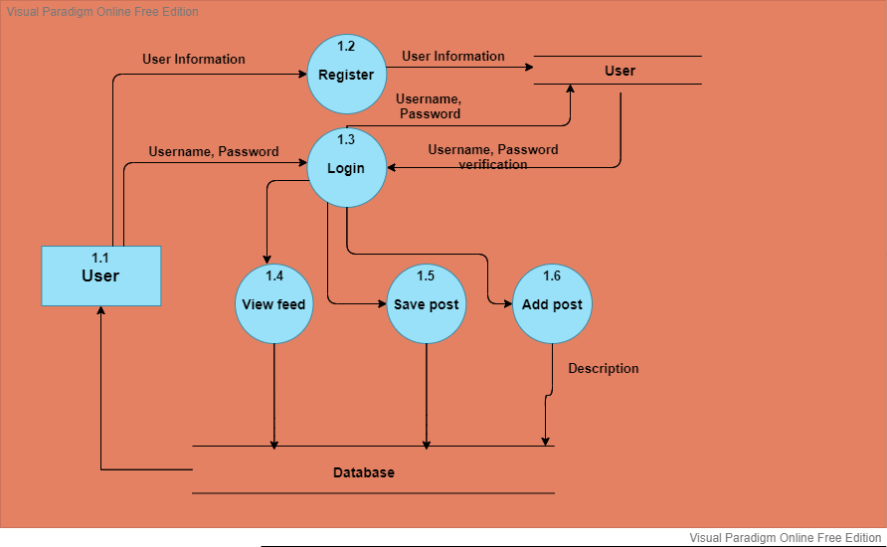

Slide 16
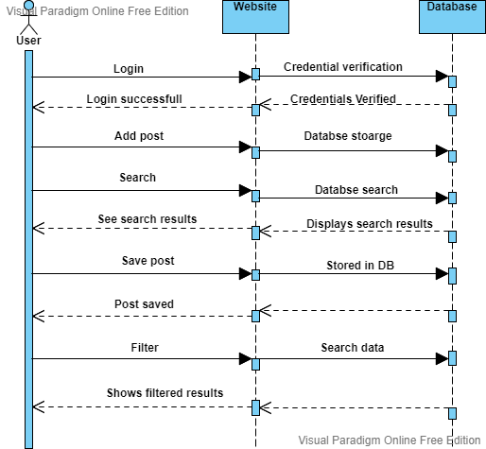
Sequence Diagram

Slide 17
Technologies and Platform used for development
Technologies:-
Front end:- Django, HTML, CSS, Javascript, Jquery, Bootstrap.
Back end:- Django, PostgreSQL
Platform:-
Visual Studio Code.

Slide 18
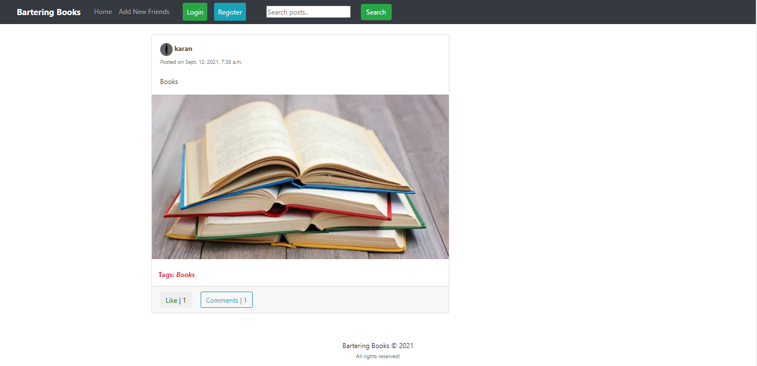
Implementation
Home Page

Slide 19
Implementation
Home Page Before Login

Slide 20
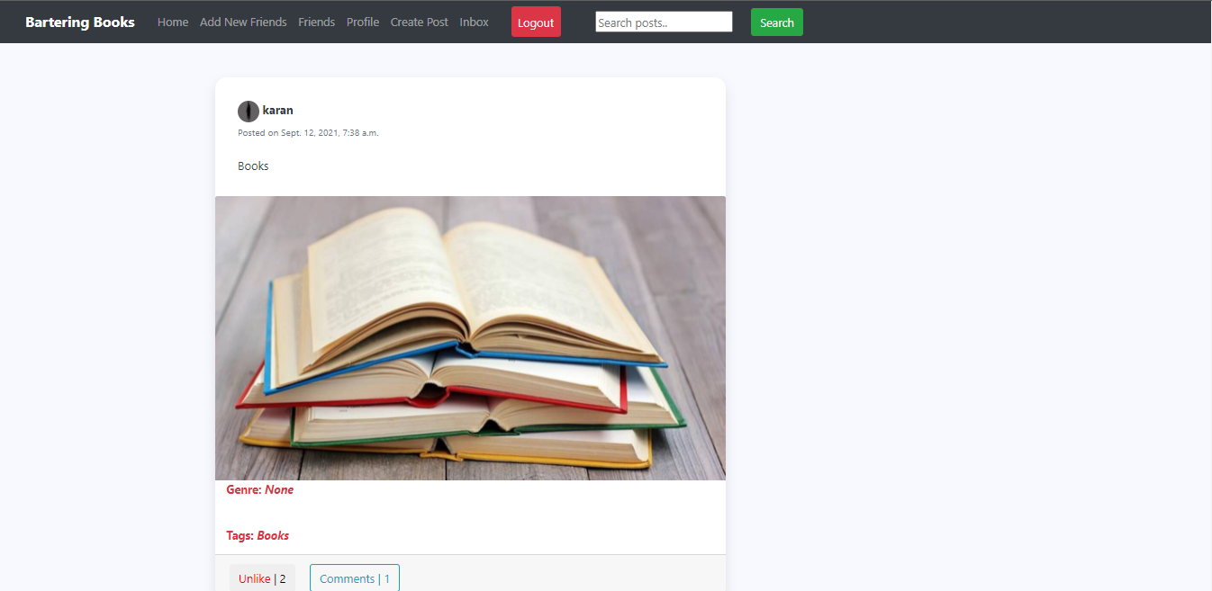
Implementation
Home Page After Login

Slide 21
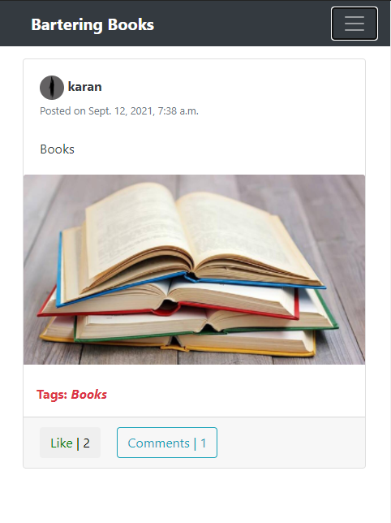
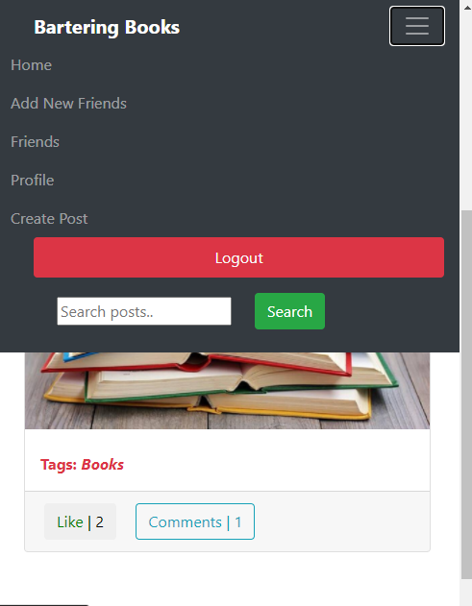
Implementation
Mobile view.

Slide 22
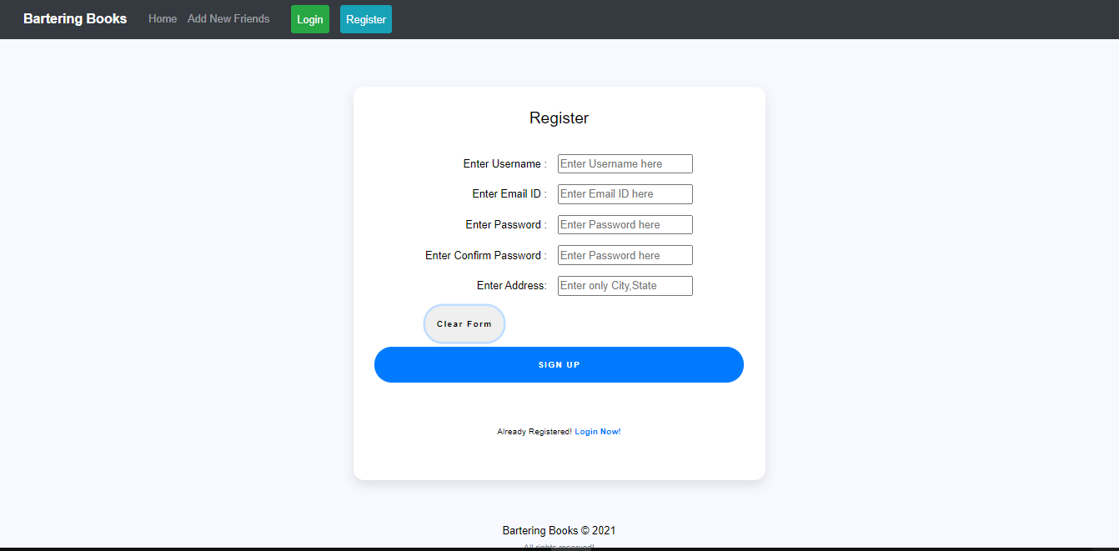
Implementation
Register

Slide 23
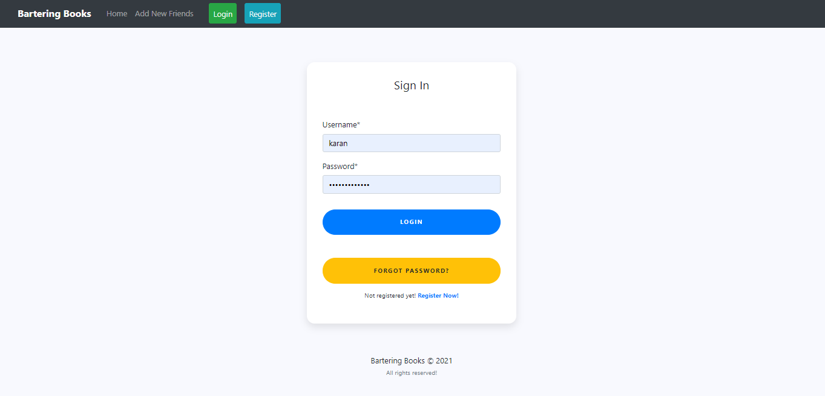
Implementation
Login

Slide 24
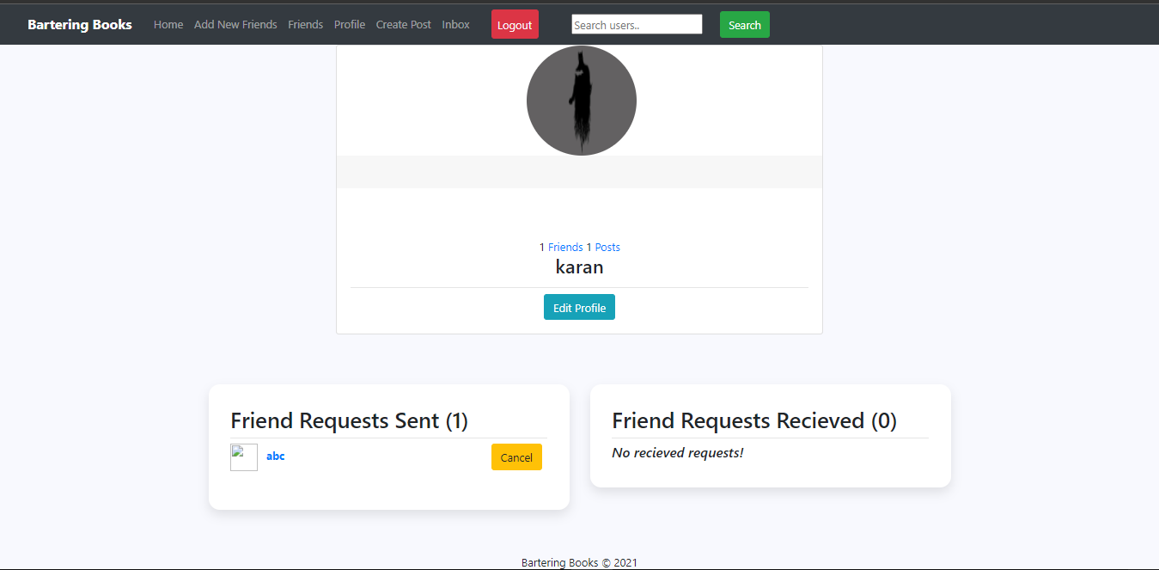
Implementation
Profile

Slide 25
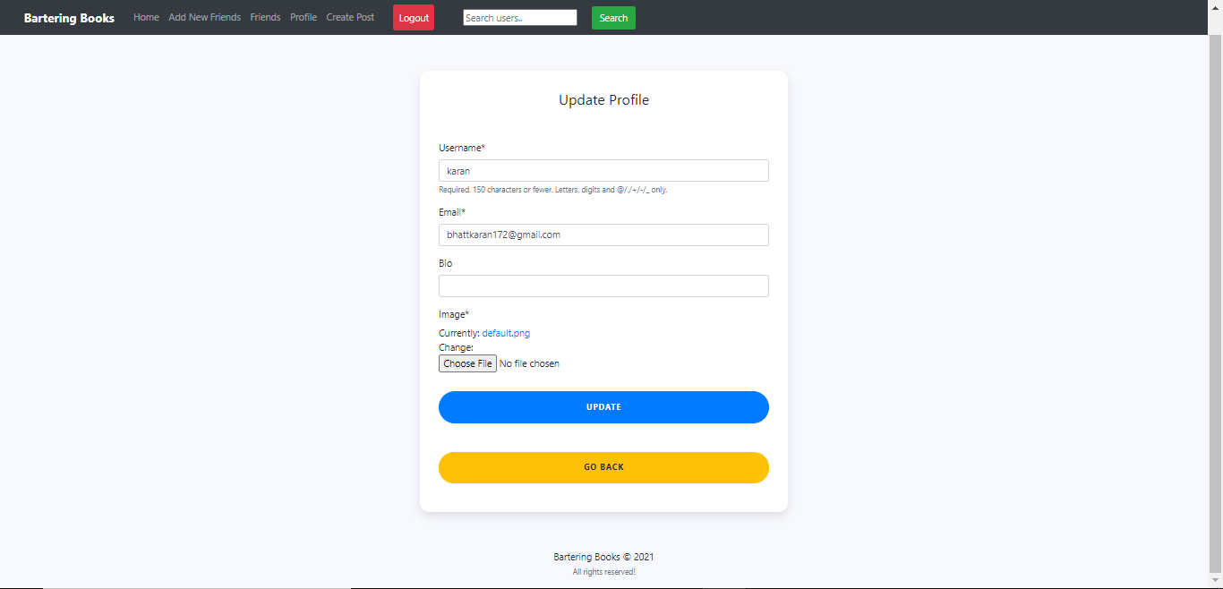
Implementation
Profile Updation

Slide 26
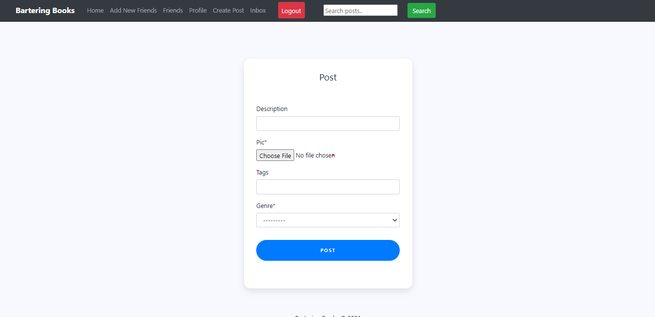
Implementation
Uploading post

Slide 27
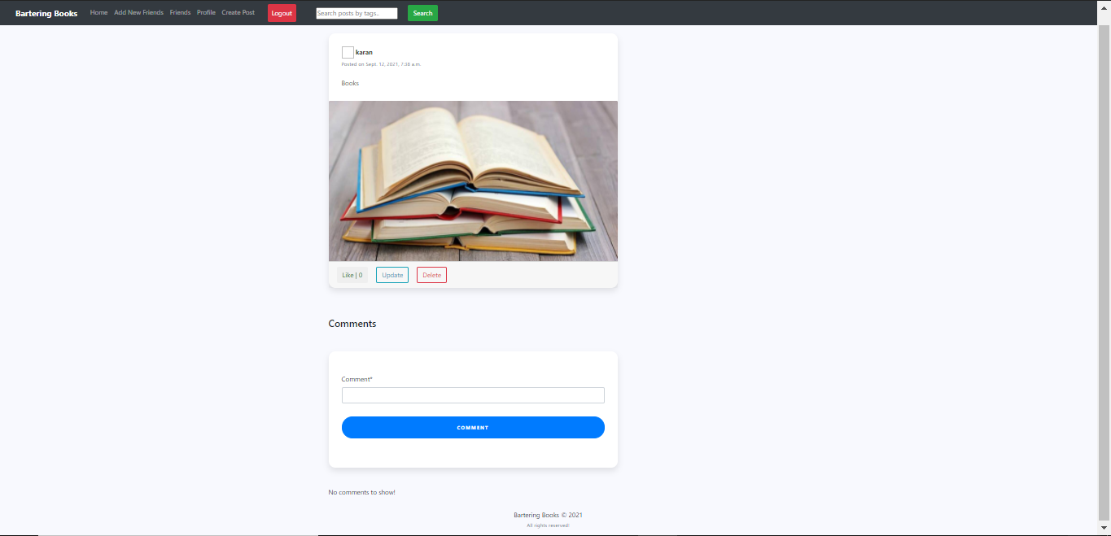
Implementation
Post Uploaded

Slide 28
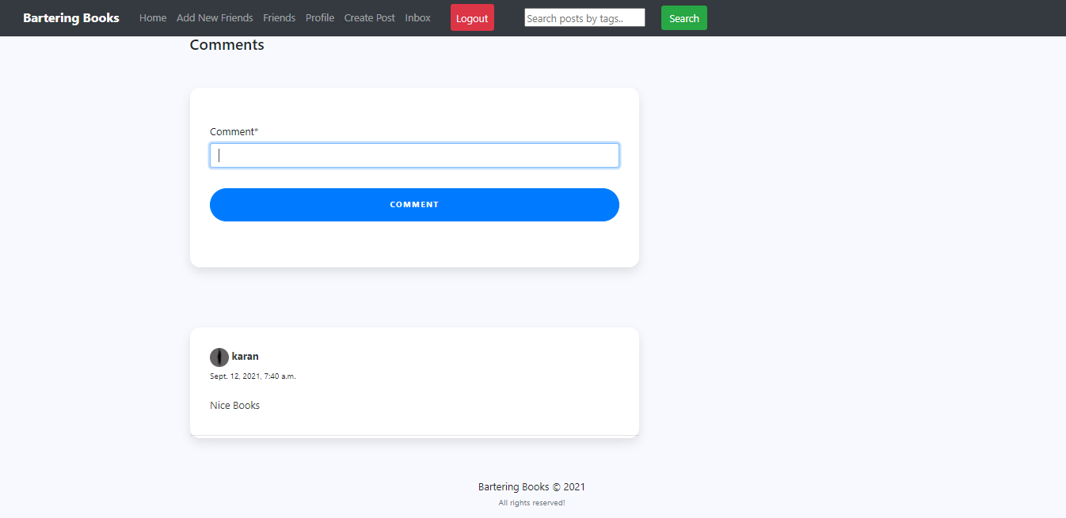
Implementation
Making Comments

Slide 29
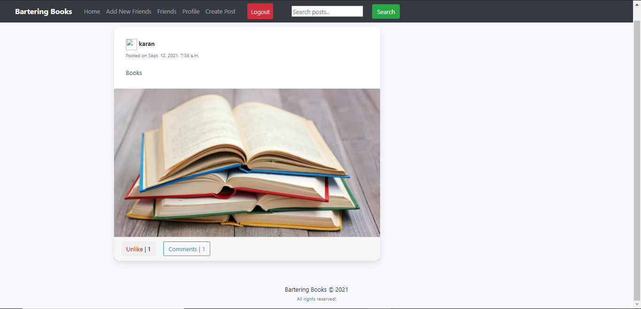
Implementation

Slide 30
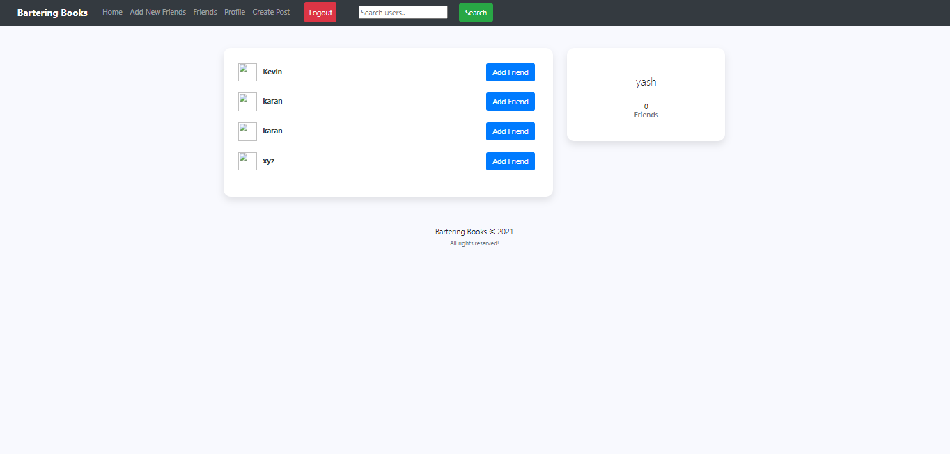
Implementation
Add Friends

Slide 31
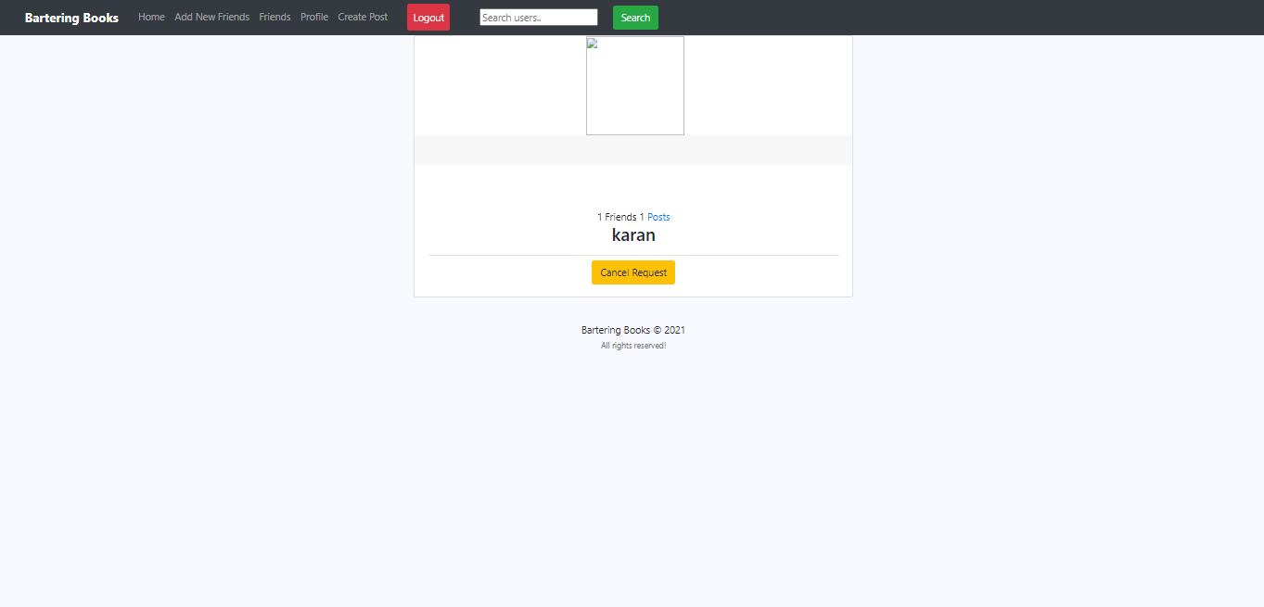
Implementation
Sending Friend Request

Slide 32
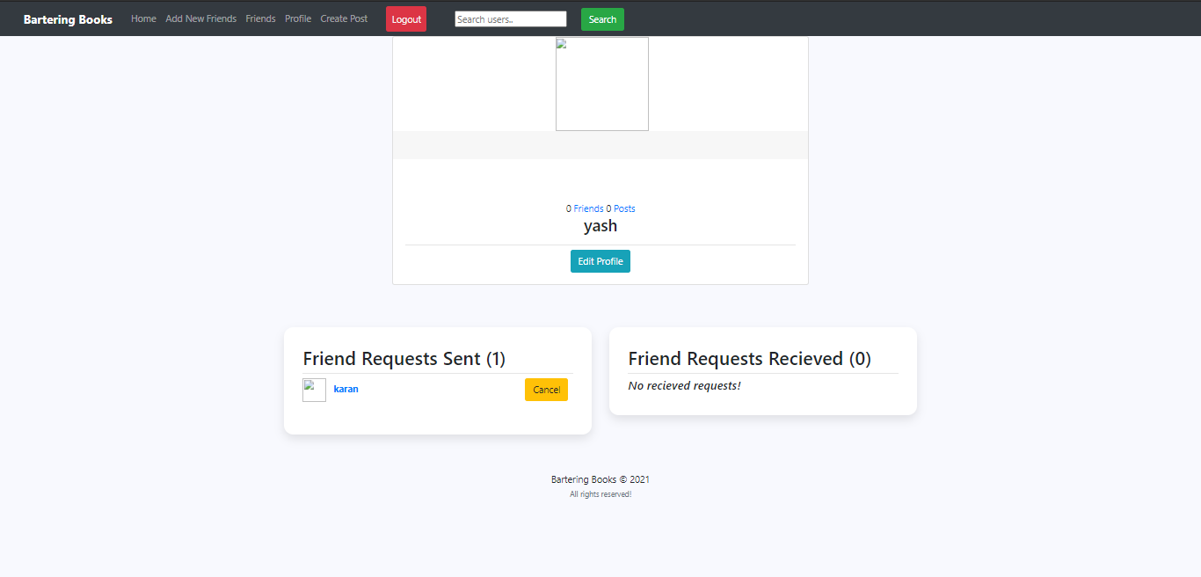
Implementation
Friend Request Sent

Slide 33
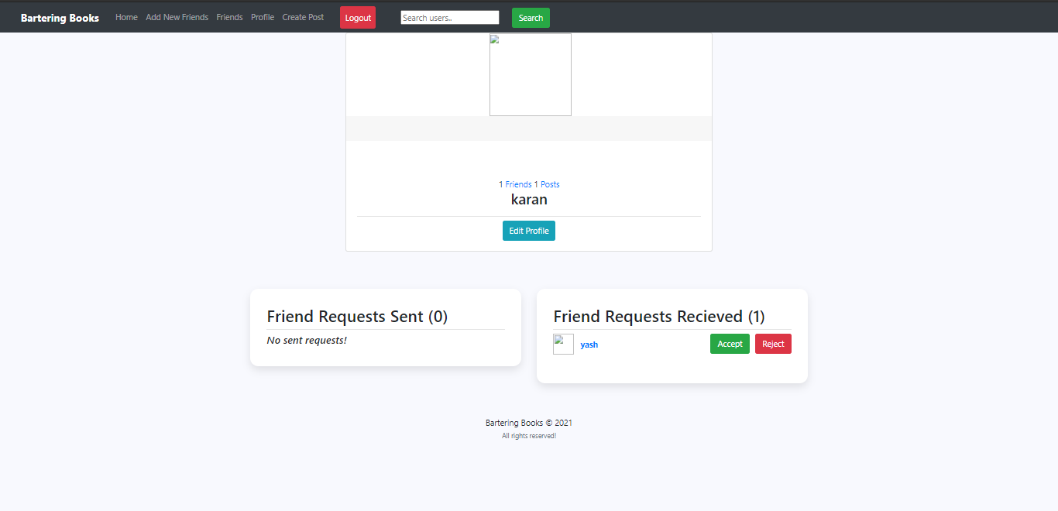
Implementation
Friend Request recieved

Slide 34
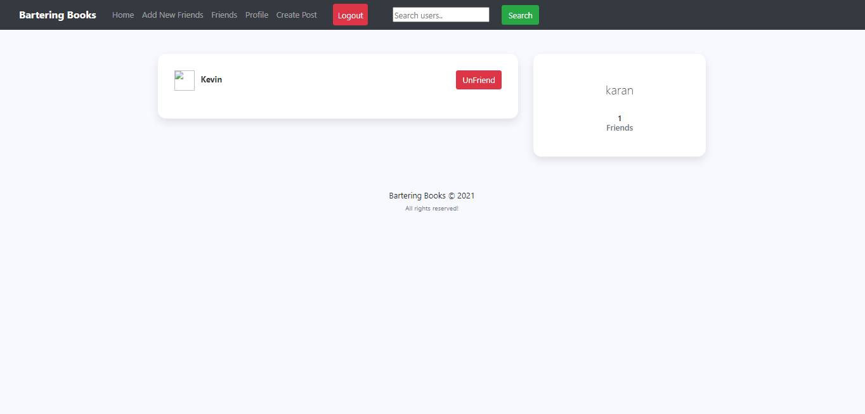
Implementation
Friends list

Slide 35
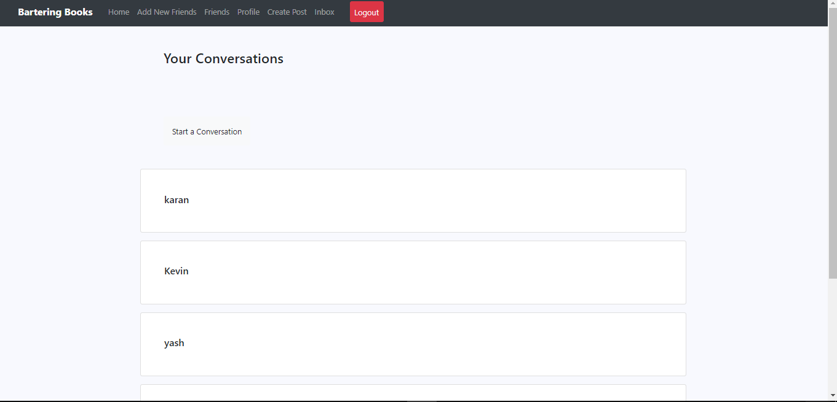
Implementation
Inbox

Slide 36
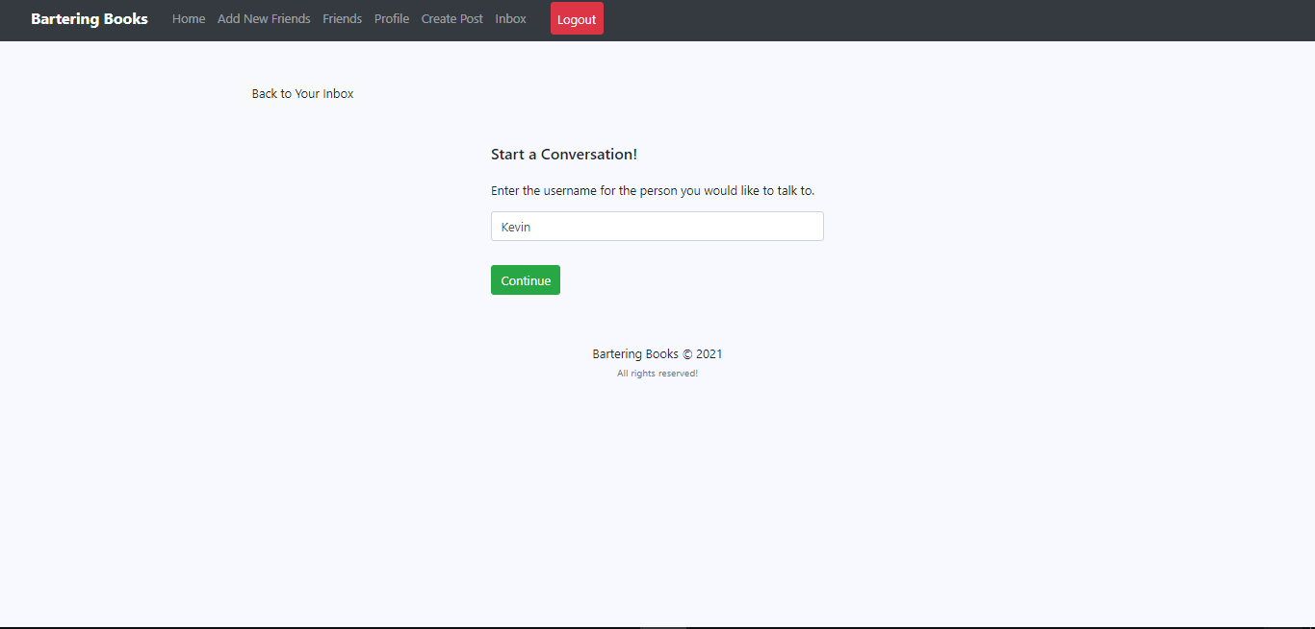
Implementation
Starting a conversation

Slide 37
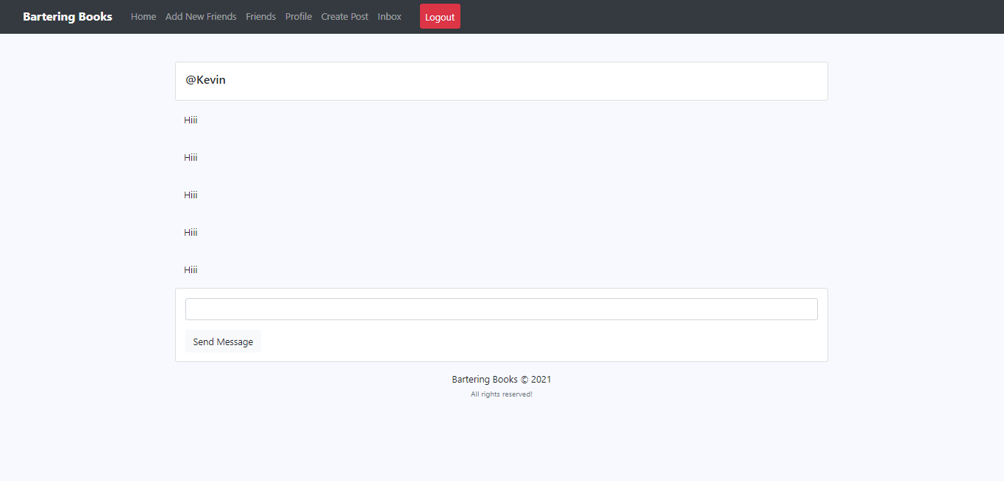
Implementation
Sending messages to another user

Slide 38
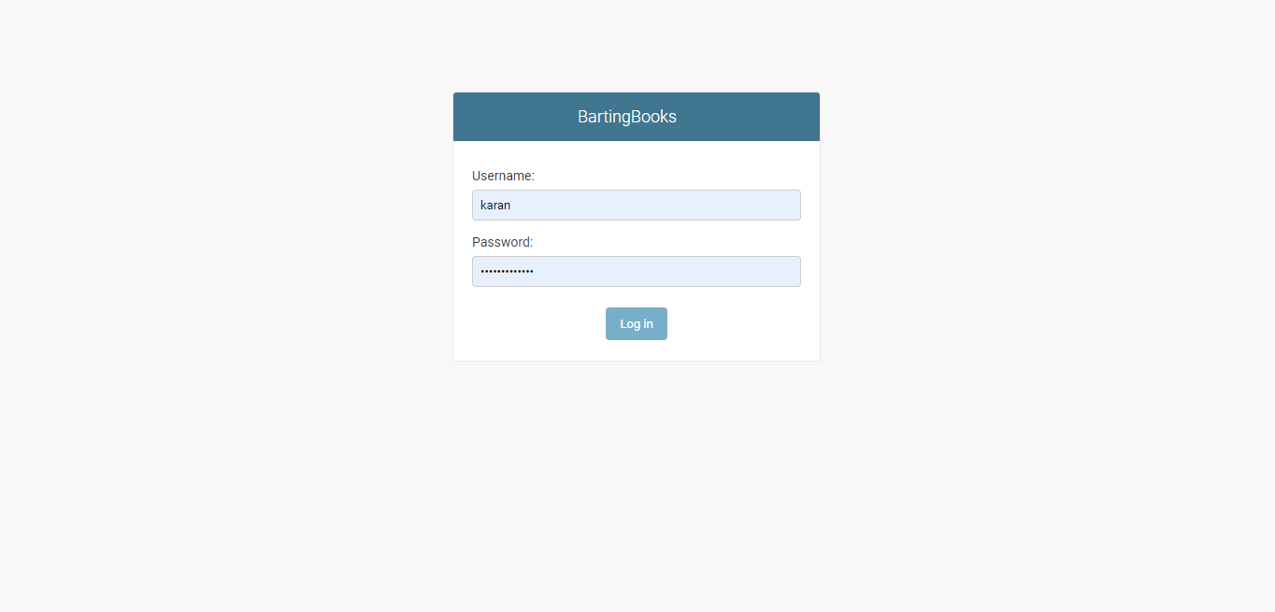
Implementation
Admin Panel Login

Slide 39
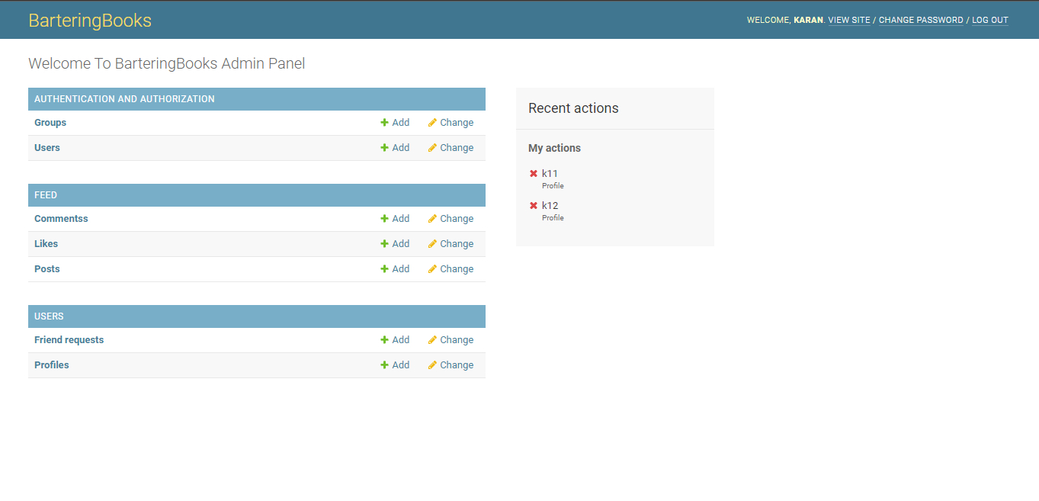
Implementation
Admin Panel

Slide 40
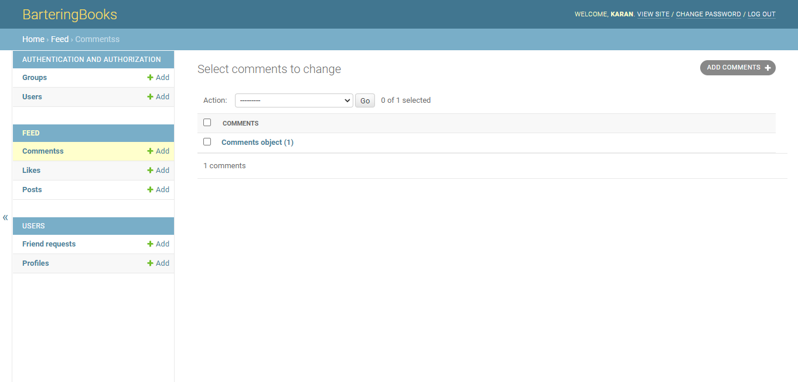
Implementation
Comments

Slide 41
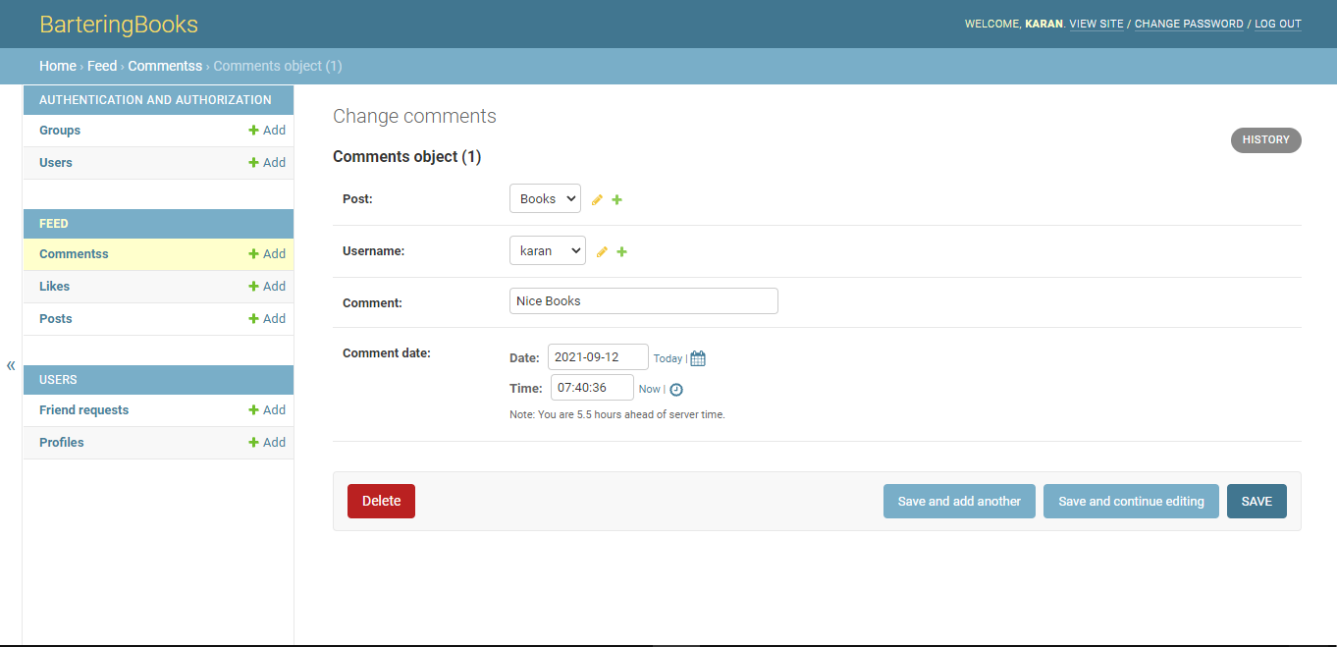
Implementation
Comments

Slide 42
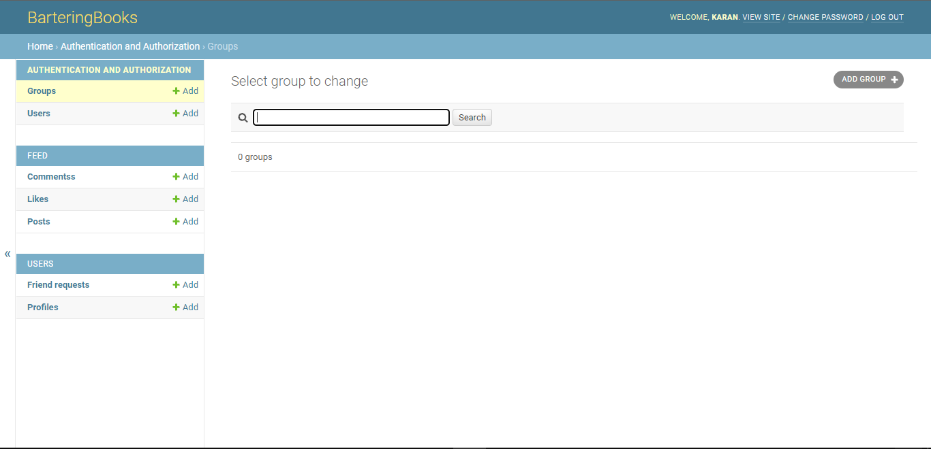
Implementation
Groups

Slide 43
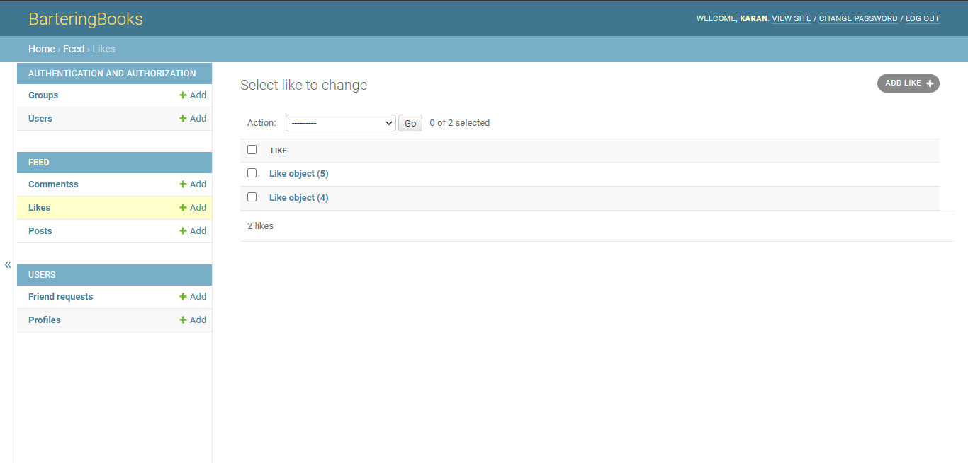
Implementation
Likes

Slide 44
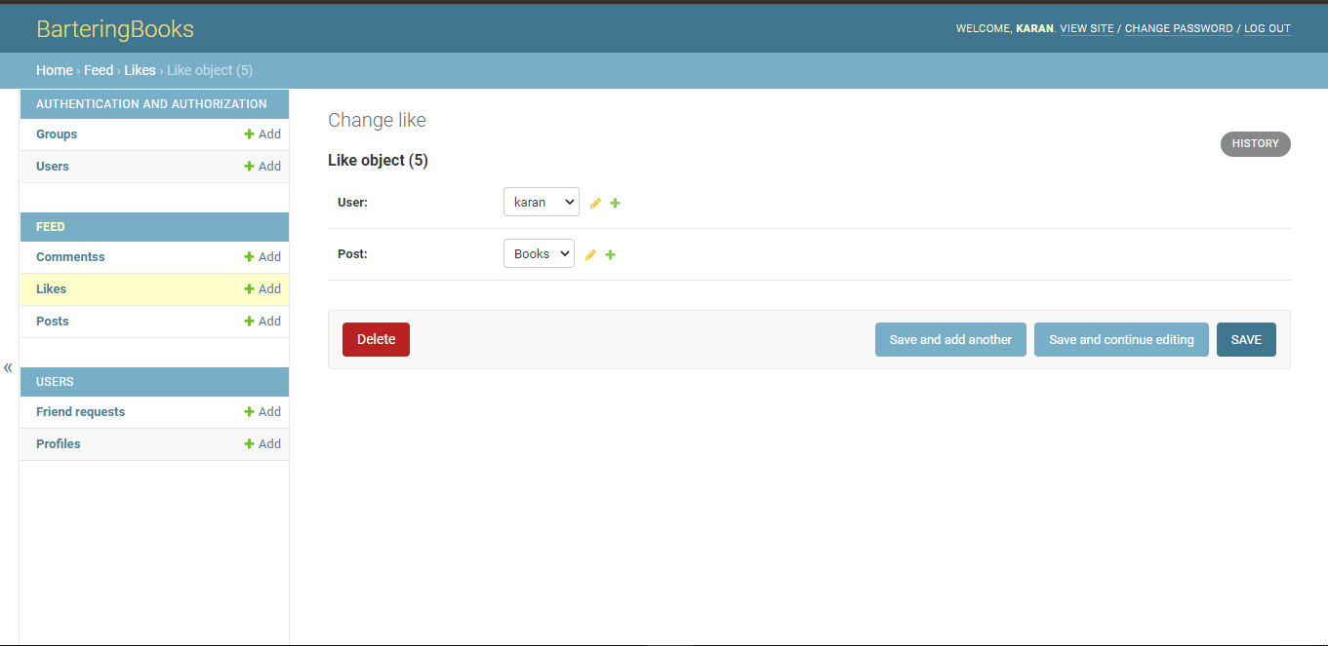
Implementation
Likes

Slide 45
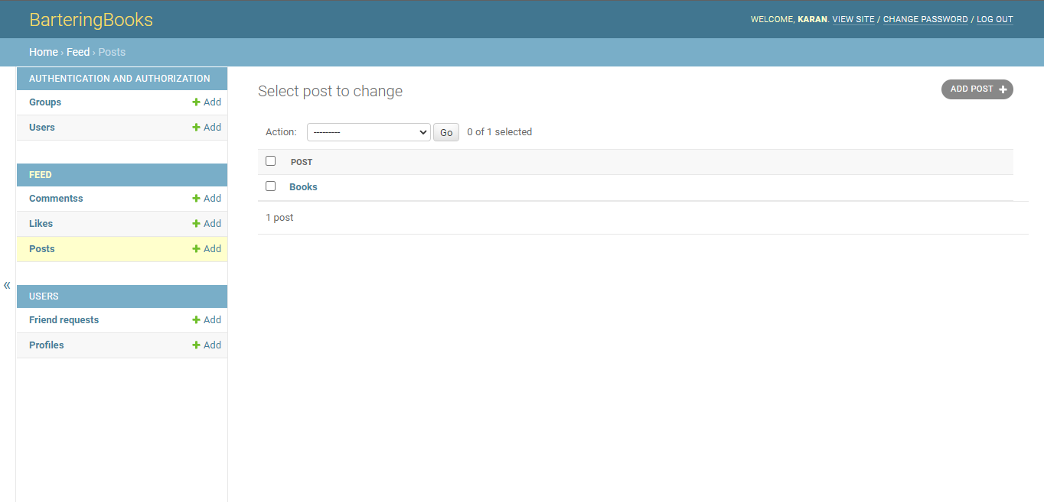
Implementation
Posts

Slide 46
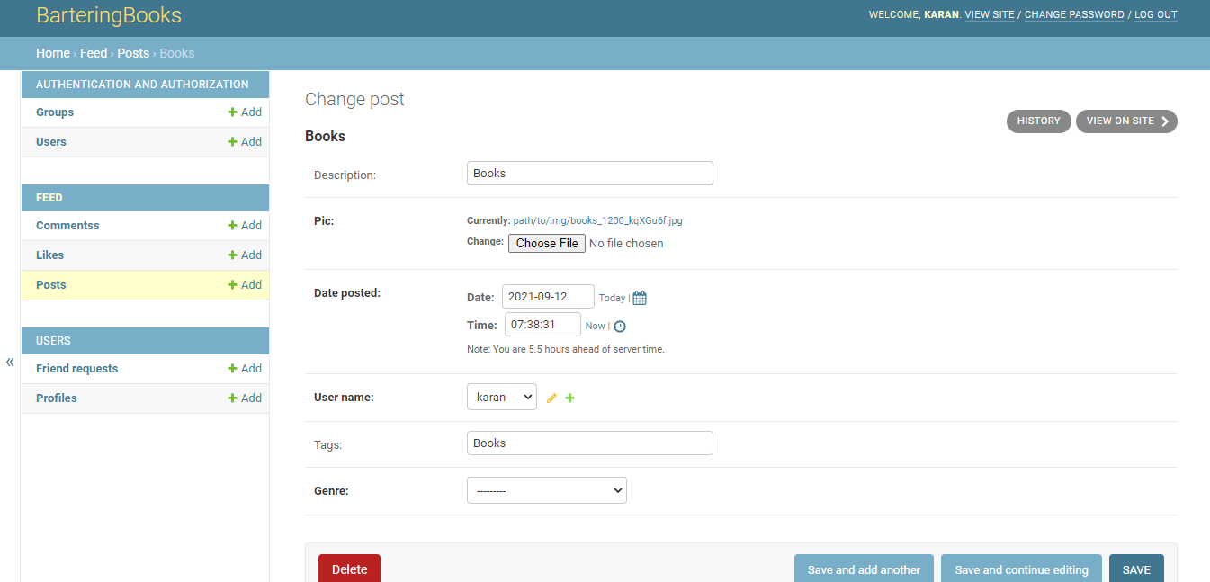
Implementation
Posts

Slide 47
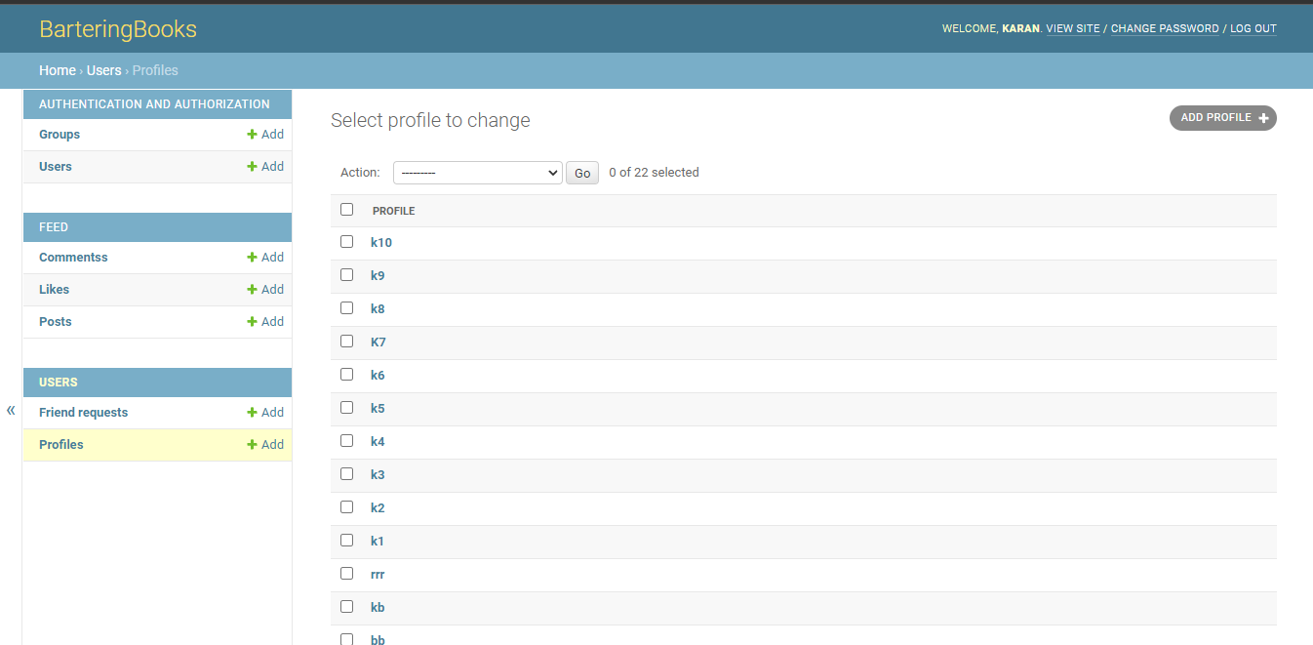
Implementation
Admin Profiles

Slide 48
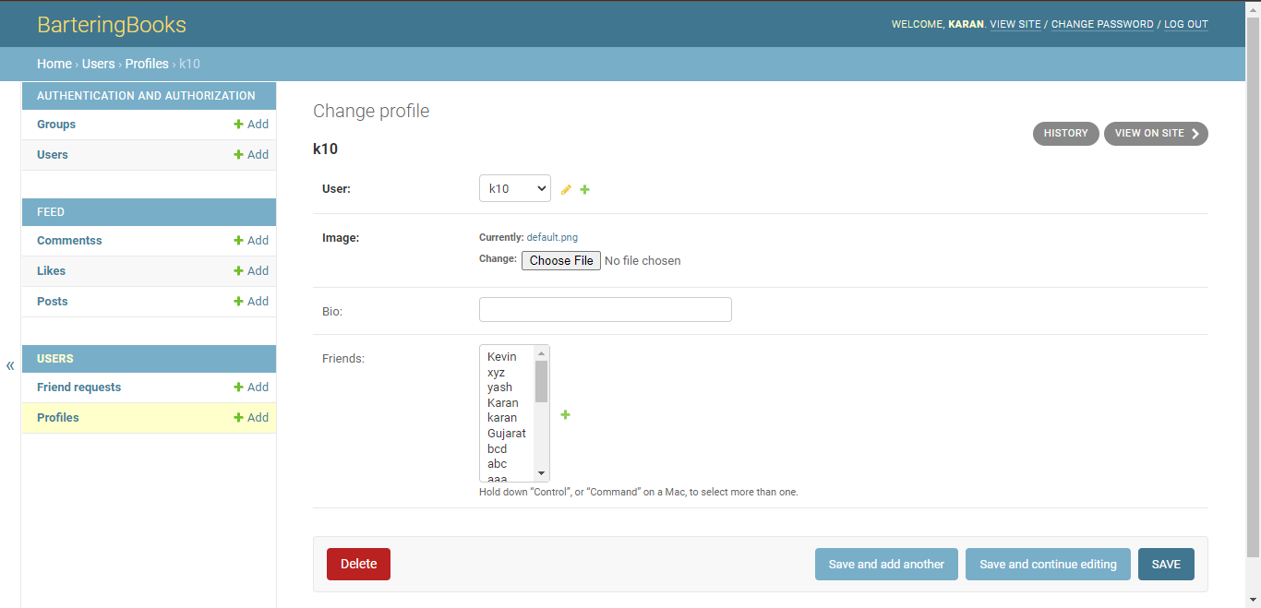
Implementation
Admin Profiles

Slide 49
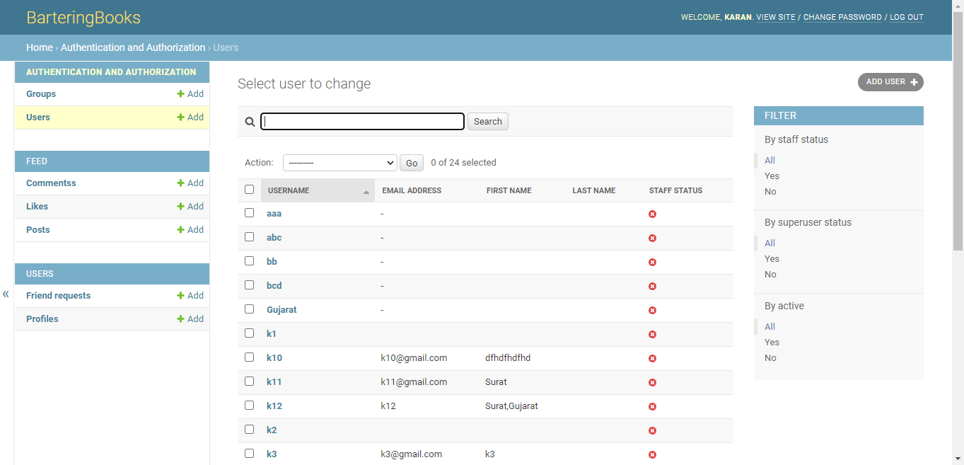
Implementation
Admin Users

Slide 50
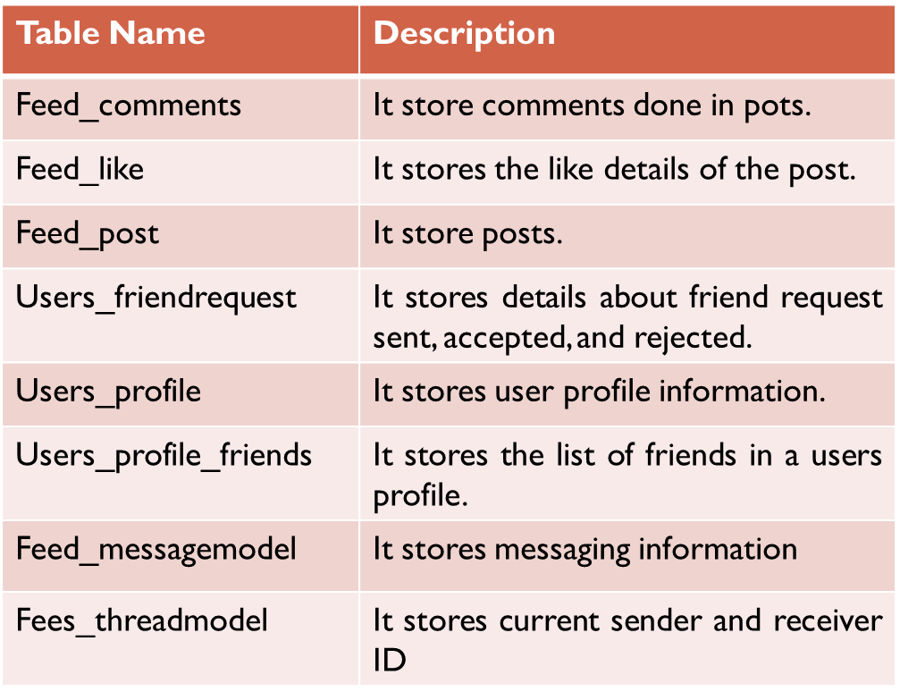
Implementation
Databases

Slide 51
Future work
In future following modules will be implemented:-
Location feed generation
Leader Board

Slide 52
Conclusion
To summarize the overall presentation, we have completed most of the modules of the entire project.
In the future, we will be working on the left out modules and on more advanced features which can provide a more better version of project.

Slide 53
References
[online]https://docs.djangoproject.com/en/3.2/ [Date of Access:20-08-2021]
[online]https://www.bookcrossing.com/[Date of Access:22-08-2021]
[online]https://ndl.iitkgp.ac.in/[Date of Access:22-08-2021]
[online]https://www.mypustak.com/[Date of Access:27-08-2021]

Slide 54
Thank You

